Slide 1

Chapter 01- [2]
Introducing Bootstrap 4
https://www.w3schools.com/bootstrap4/bootstrap_get_started.asp
Notes:
Session: Ghi số thứ tự session trong môn học
Session Name: ghi tên của session sẽ dạy

Slide 2
Objectives
Bootstrap is the most popular HTML, CSS, and JavaScript framework on the planet. In this chapter we’ll learn:
Introduction to Bootstrap 4
Bootstrap Grid System
Bootstrap Component
Add Bootstrap to project
First Project with Bootstrap
Notes:
Mô tả nội dung mà học viên phải đạt được khi kết thúc môn học này

Slide 3
Introduction Bootstrap 4
Notes:
Session: Ghi số thứ tự session trong môn học
Session Name: ghi tên của session sẽ dạy

Slide 4

Definitions
Bootstrap is a free and open-source framework for creating websites and web applications. It's the most popular HTML, CSS, and JS framework for developing responsive, mobile first projects on the web.
Bootstrap is completely free to download and use!
“One Framework, Every Device”

Slide 5
Why Use Bootstrap?
Easy to use: Anybody with just basic knowledge of HTML and CSS can start using Bootstrap
Responsive features: Bootstrap's responsive CSS adjusts to phones, tablets, and desktops
Mobile-first approach
Browser compatibility: (Chrome, Firefox, Internet Explorer, Safari, and Opera)

Slide 6
Bootstrap 3 vs. Bootstrap 4
Bootstrap 4 is the newest version of Bootstrap; with new components, faster stylesheet and more responsiveness.
Bootstrap 4 supports the latest, stable releases of all major browsers and platforms. However, Internet Explorer 9 and down is not supported.

Slide 7
Bootstrap 4 Grid System
Notes:
Session: Ghi số thứ tự session trong môn học
Session Name: ghi tên của session sẽ dạy

Slide 8
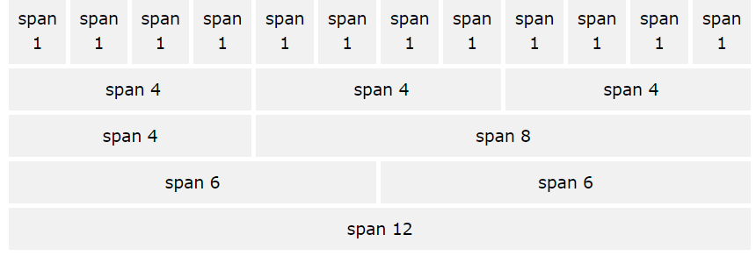
Bootstrap 4 Grid System
Bootstrap's grid system allows up to 12 columns across the page.
Bootstrap's grid system is responsive, and the columns will rearrange depending on the screen size
If you do not want to use all 12 column individually, you can group the columns together to create wider columns:

Slide 9
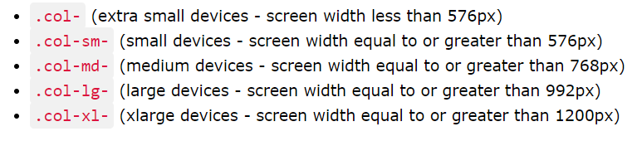
Grid Classes
The Bootstrap 4 grid system has five classes:
The classes above can be combined to create more dynamic and flexible layouts.

Slide 10
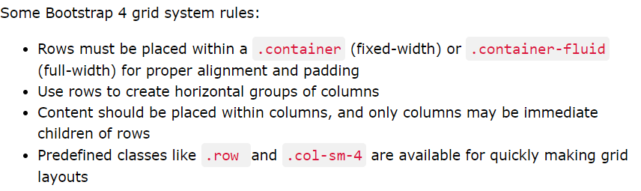
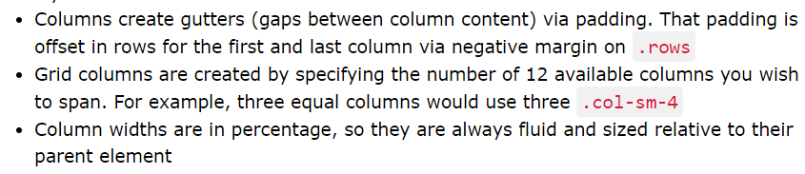
Grid System Rules

Slide 11
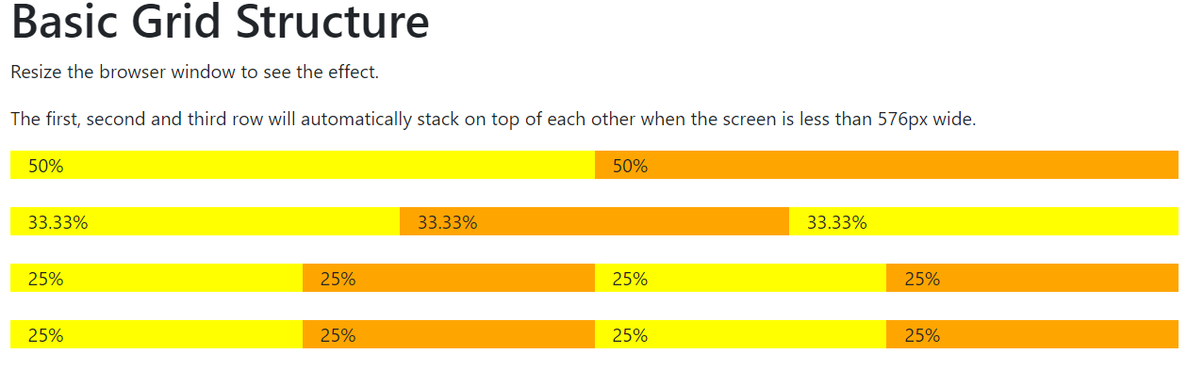
Basic Grid Structure
Example

Slide 12
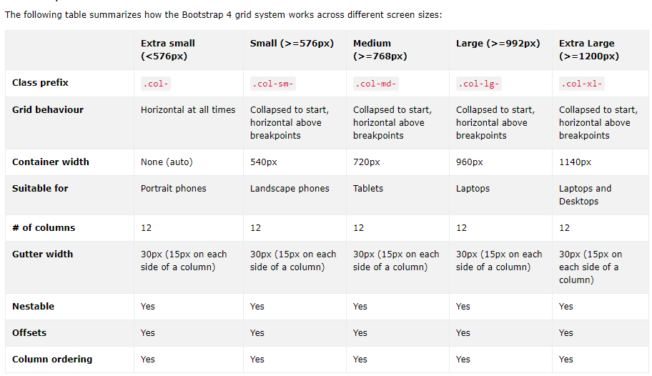
Grid Sizes

Slide 13
Bootstrap Component
Notes:
Session: Ghi số thứ tự session trong môn học
Session Name: ghi tên của session sẽ dạy

Slide 14
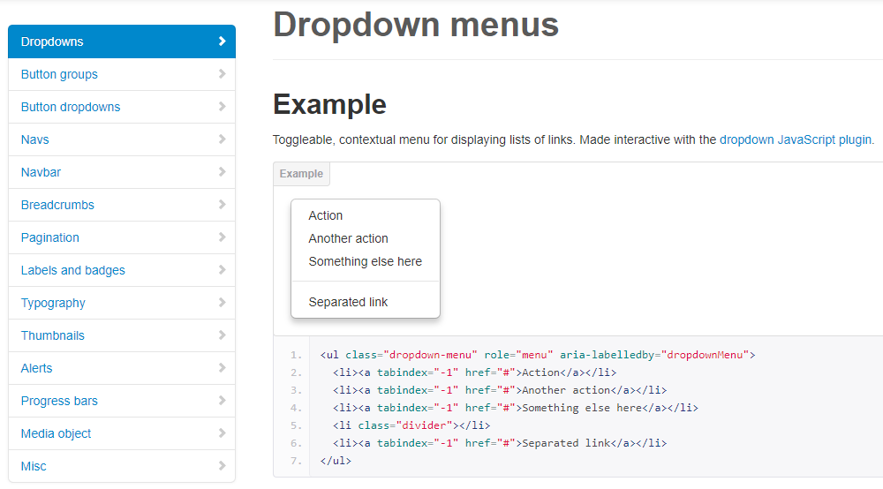
Components
Dozens of reusable components built to provide navigation, alerts, popovers, and more.
2. Demo sv: file:///E:/IVietTech/Front%20End-2017/Web%20Design/Slide-Boapstrap/Best%20Demo%20Bootsrap/portal-OK/index.html
1. http://getbootstrap.com/2.3.2/components.html
Notes:
Links to components of bootstrap:
http://getbootstrap.com/2.3.2/components.html

Slide 15
Add BootStrap to project
Notes:
Session: Ghi số thứ tự session trong môn học
Session Name: ghi tên của session sẽ dạy

Slide 16
Where to Get Bootstrap?
There are two ways to start using Bootstrap 4 on your own website. You can:
Download Bootstrap 4 from getbootstrap.com
Include Bootstrap 4 from a CDN
http://getbootstrap.com/2.3.2/getting-started.html

Slide 17
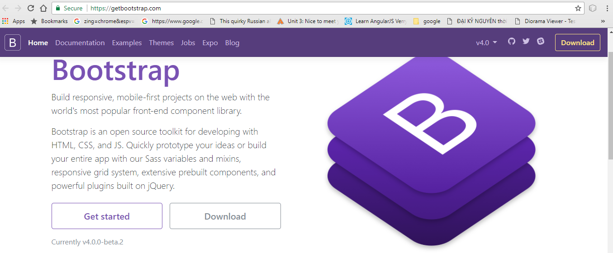
Downloading Bootstrap 4
If you want to download and host Bootstrap yourself, go to getbootstrap.com, and follow the instructions there.

Slide 18
Bootstrap 4 CDN
If you don't want to download and host Bootstrap yourself, you can include it from a CDN (Content Delivery Network).
MaxCDN provides CDN support for Bootstrap's CSS and JavaScript. You must also include jQuery:

Slide 19
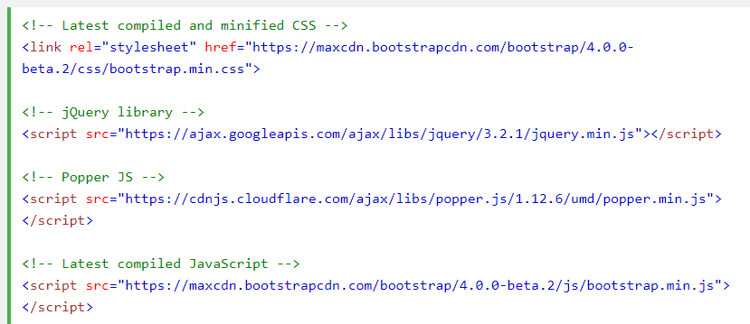
Bootstrap 4 CDN (tt)
Notes:
<!-- Latest compiled and minified CSS --> <link rel="stylesheet" href="https://maxcdn.bootstrapcdn.com/bootstrap/4.0.0-beta.2/css/bootstrap.min.css"> <!-- jQuery library --> <script src="https://ajax.googleapis.com/ajax/libs/jquery/3.2.1/jquery.min.js"></script> <!-- Popper JS --> <script src="https://cdnjs.cloudflare.com/ajax/libs/popper.js/1.12.6/umd/popper.min.js"></script> <!-- Latest compiled JavaScript --> <script src="https://maxcdn.bootstrapcdn.com/bootstrap/4.0.0-beta.2/js/bootstrap.min.js"></script>

Slide 20
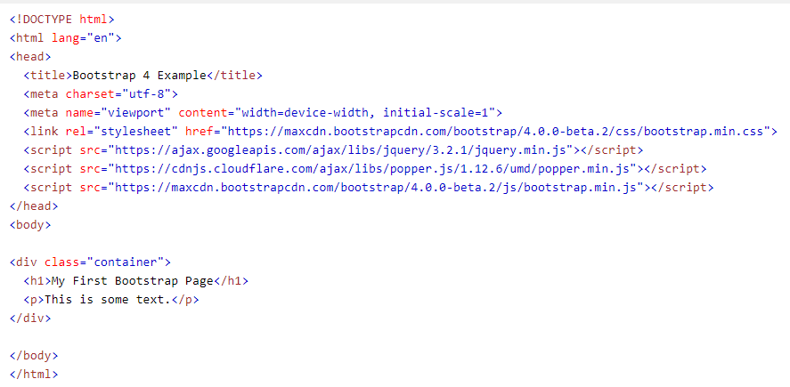
Create First Web Page With Bootstrap 4
A Web Page responsive fixed width container
Notes:
https://www.w3schools.com/bootstrap4/tryit.asp?filename=trybs_gs_container&stacked=h

Slide 21
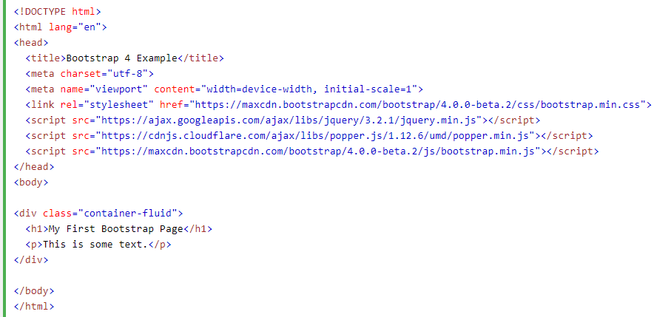
Create First Web Page With Bootstrap 4
A Web Page full width container
Notes:
https://www.w3schools.com/bootstrap4/tryit.asp?filename=trybs_gs_container&stacked=h

Slide 22
First Project with Bootstrap
Notes:
Session: Ghi số thứ tự session trong môn học
Session Name: ghi tên của session sẽ dạy

Slide 23
Steps for project with Bootstrap 4
Create a project in IDE (Dreamweaver CS6 or NetBeans)
Download Bootstrap 4
Unzip file zip
Copy directory Bootstrap 4 to root website
Create First Web Page With Bootstrap 4

Slide 24
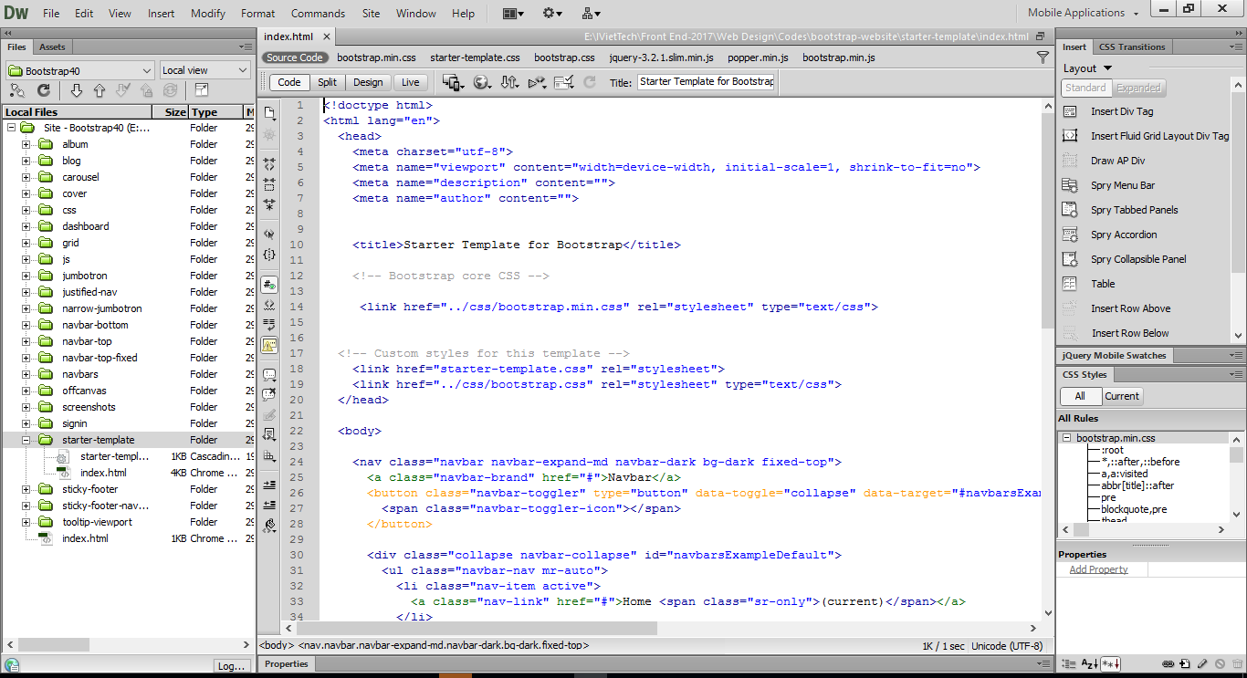
Steps for project with Bootstrap 4

Slide 25
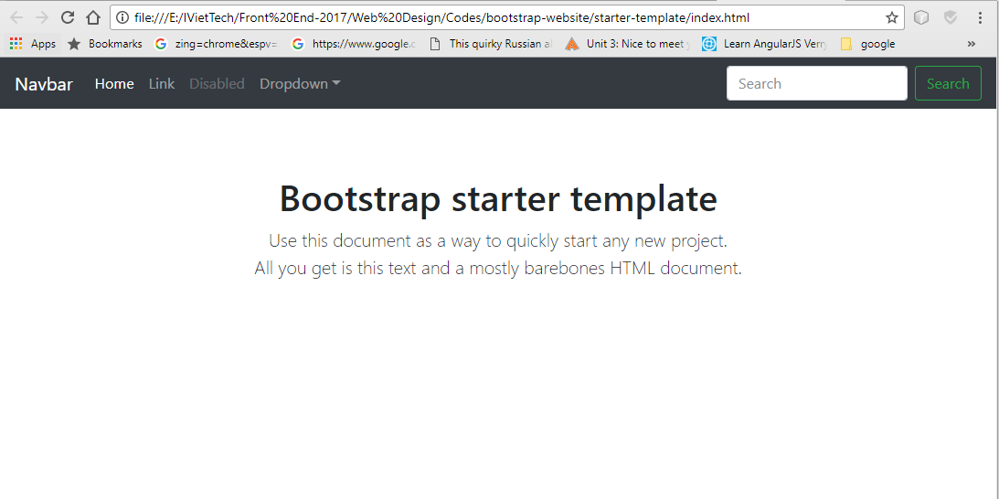
Steps for project with Bootstrap 4

Slide 26
Summary
That brings the first chapter to a close. I hope this chapter has proved to be a good introduction to Bootstrap 4 and provided you with a few advanced techniques for setting up your Bootstrap projects.
Notes:
Tóm tắt lại nội dung đã học

Slide 27
Discussion
Why’re you use the Bootstrap 4?
Notes:
Trả lời câu hỏi WHY?

